Slide 1
2016 Region I SAFECON

Slide 2
Chief Judge Website
https://nifa.aero/chief-judge/region-1
Check often

Slide 3
Role Call
Utah State University
Westminster College
Rocky Mountain College
Colorado Northwestern Community College
Metropolitan State University of Denver
United States Air Force Academy

Slide 4
Housekeeping
Alcohol rule
Fitness for duty
Flying other than for competition
Trash/FOD
Cameras/recording devices prohibited
Be flexible
Contestant ID number & photo ID

Slide 5
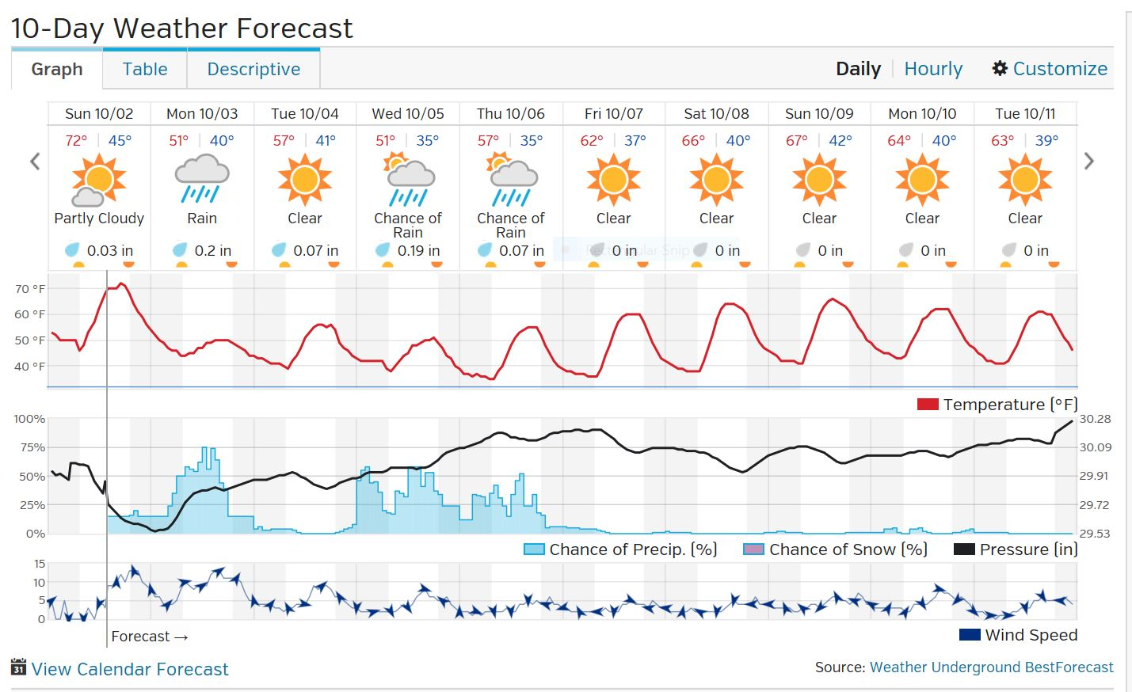
WX Forecast/Schedule
Notes:
Probably Nav on Tue
Be prepared for any event at any time and location!
Might be testing in hangar
Sim might be moved up to Monday

Slide 6
Landing Events
Score best 2 out of 3
Heats of 3
Be alert for transient traffic
Traffic pattern limits
Electronic Landing Cards

Slide 7
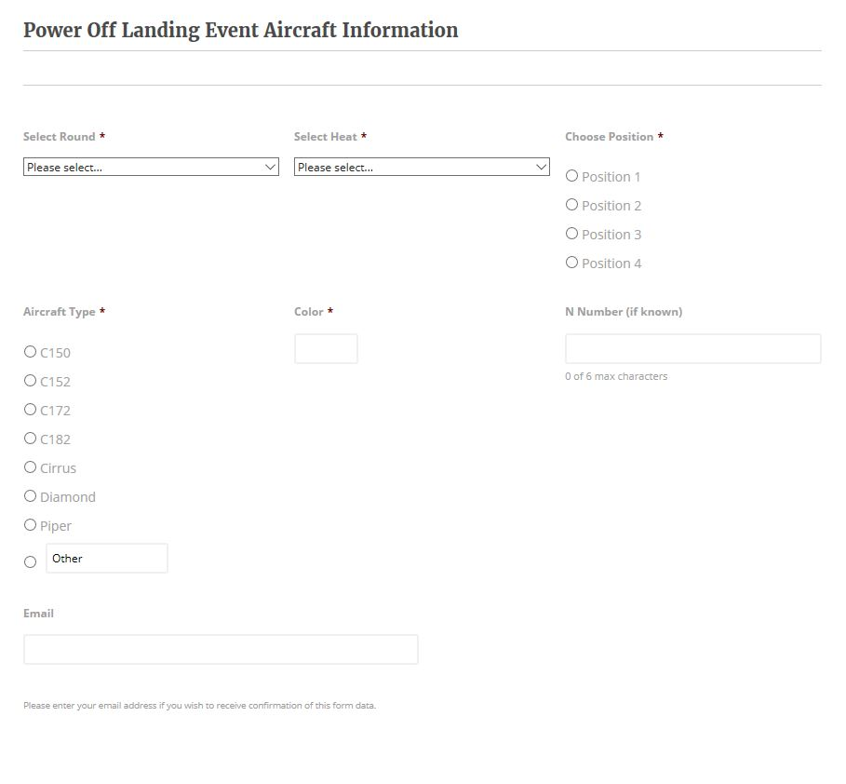
Landing Events

Slide 8
Navigation Event
South side of SLC sectional
North side may provide additional terrain/situational awareness
TERRAIN WARNING!
B Route has high terrain between B2 and B3
10,500’ MSL mandatory altitude
Emergencies
Lost
Land off site
ONCE YOU ARE SAFE, call the Chief Judge

